Slide 1
QoS Automation Tool
Nov 2021
Fernando Figliolo
Team: Breaking Bad
FLC CASA

Slide 2
Agenda
What is it?
Carrier QUEUE-DSCP Mapping
Components
Script Workflow
How it Works
Questions?

Slide 3
What is it?
It’s a tool to setup new QoS class-map values.
Values to be configured:
Real Time Traffic %
Video Class-map %
D1 Class-map %
D2 Class-map %
D3 Class-map %
D4 Class-map %
Main parameters are Real Time and Video Class-maps to improve Skype & Zoom performance.
It doesn’t change any other parameter like class-map names, neither policy-map (4Q, 5Q, 6Q…) or DSCP mapping.
It doesn´t check if whole QoS configuration is correct.
The script was written in Python.

Slide 4
Carrier QUEUE-DSCP Mapping
AT&T 4Q | AT&T 6Q | ORANGE 5Q
REAL TIME | REAL TIME | REAL TIME
D1 | VIDEO | VIDEO
D2 | D1 | D1
D3 | D2 | D2
 | D3 | D3
 | D4
i.e.
AT&T 6Q Options:
10% RT, 10/10/50/25/5
20% RT, 20/10/40/25/5
20% RT, 20/10/50/15/5
20% RT, 20/10/60/5/5

Slide 5
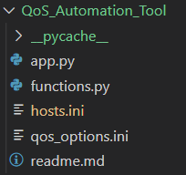
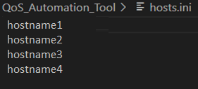
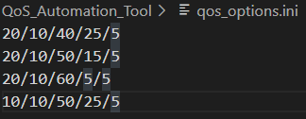
Components
Input module:
Routers hostname list
Predefined remaining QoS values option list
User’s Input Interface:
Real time value
Remaining bandwidth Option Selection
Configuration module
Verification module
Output module

Slide 6
Script Workflow
1.
2.
3.
Input Values
Change QoS Settings
Verify QoS Change
Input REAL-TIME value
Get Hosts List
Get Current QoS Settings
Get QoS Settings
Get QoS Options
Is QoS the same type as new?
No
Not Modify
Has QoS the same values as new?
No
QoS Change Failure
Select New QoS Settings
Yes
Yes
Has QoS the same values as new?
No
Configure New QoS Values
QoS Change Success
Yes
Not Modify

Slide 7
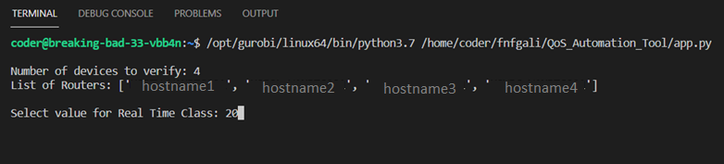
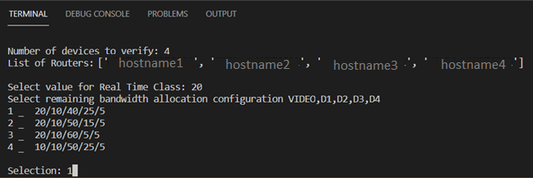
How it Works
1_ Insert Real Time value %
2_ Choose option for remaining bandwidth distribution for each Class-Math %

Slide 8
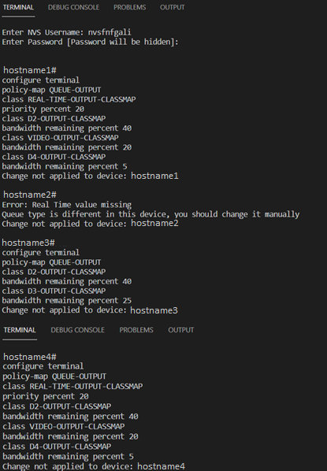
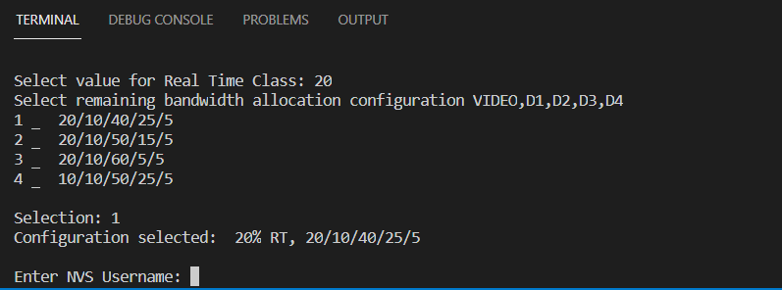
How it Works
3_ Enter NVS login credentials and start applying
None of the configurations are applied as this is a demo!
An error found in the device configuration. Nothing is going to be applied. You should do it manually.

Slide 9
Questions?

